Slide 1

Geometry
Unit 7, Lesson 8 Using Trigonometric Ratios and the Pythagorean Theorem Volume 1, pg. 416

Slide 2


Benchmark
MA.912.T.1.2
Solve mathematical and real-world problems involving right triangles using trigonometric ratios and the Pythagorean Theorem.
volume 1, pg. 416

Slide 3
Integrated Mathematical Thinking and Reasoning Standards
MA.K12.MTR.1.1 Actively participate in effortful learning both individually and collectively.
MA.K12.MTR.2.1 Demonstrate understanding by representing problems in multiple ways.
MA.K12.MTR.3.1 Complete tasks with mathematical fluency.
MA.K12.MTR.4.1 Engage in discussions that reflect on the mathematical thinking of self and others.
MA.K12.MTR.5.1 Use patterns and structure to help understand and connect mathematical concepts.
volume 1, pg. 416

Slide 4

Learning Targets
I can use trigonometric ratios to solve mathematical problems.
I can use the Pythagorean Theorem to solve mathematical problems.
volume 1, pg. 416

Slide 5

Warm-Up
volume 1, pg. 416

Slide 6
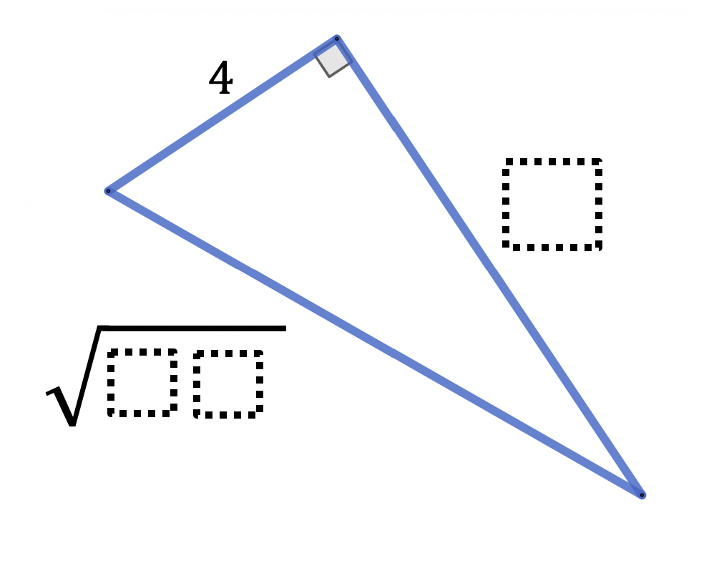
7.8.1 Warm-Up: Critical Thinking
Use the digits 0-9 one time each to find the missing side lengths of the right triangle. The triangle is not drawn to scale.
volume 1, pg. 416

Slide 7

Collaboration
volume 1, pg. 417

Slide 8

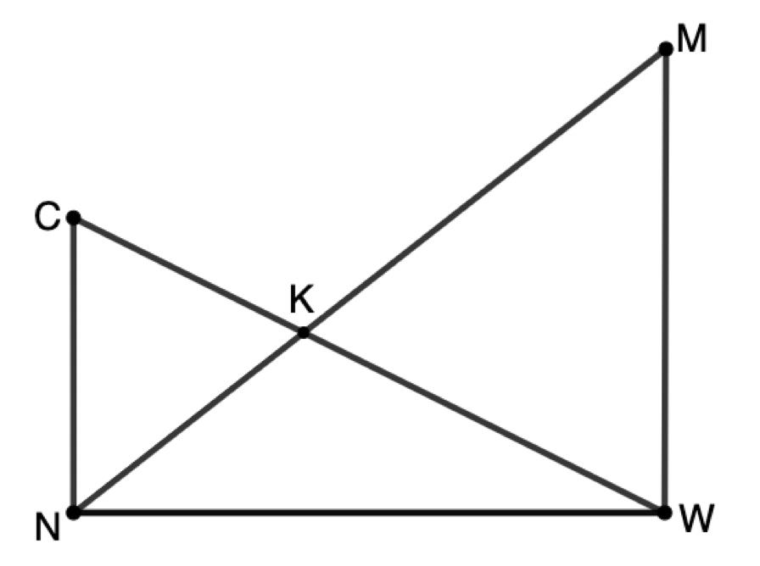
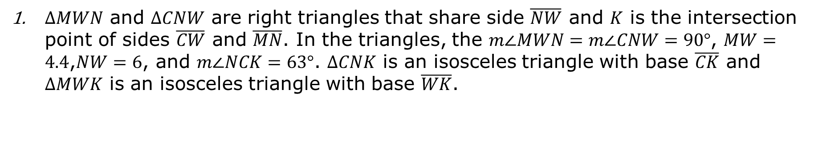
7.8.2 Collaboration: Overlapping Triangles
$∆MWN$ and $∆CNW$ are right triangles that share side $\overline{NW}$ and $K$ is the intersection point of sides $\overline{CW}$ and $\overline{MN}$. In the triangles, the $m∠MWN=m∠CNW=90°$, $MW=4.4$,$NW=6$, and $m∠NCK=63°$. $∆CNK$ is an isosceles triangle with base $\overline{CK}$ and $∆MWK$ is an isosceles triangle with base $\overline{WK}$.
Mark the figure with all information given in the problem.
volume 1, pg. 417

Slide 9
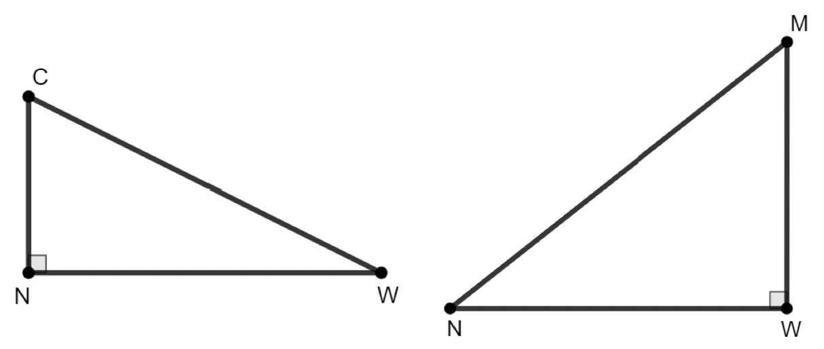
Jasmine redrew the diagram as two separate triangles, as shown. Mark Jasmine’s diagram using the given information.
volume 1, pg. 417

Slide 10
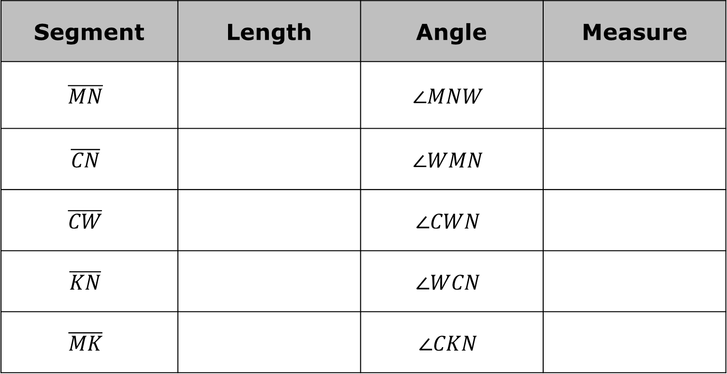
Find the measures of the segments and angles listed in the table. Round to the nearest thousandth.
Segment | Length | Angle | Measure
$$\overline{MN}$$ |  | $$∠MNW$$
$$\overline{CN}$$ |  | $$∠WMN$$
$$\overline{CW}$$ |  | $$∠CWN$$
$$\overline{KN}$$ |  | $$∠WCN$$
$$\overline{MK}$$ |  | $$∠CKN$$
volume 1, pg. 417

Slide 11

Guided Instruction
volume 1, pg. 418

Slide 12
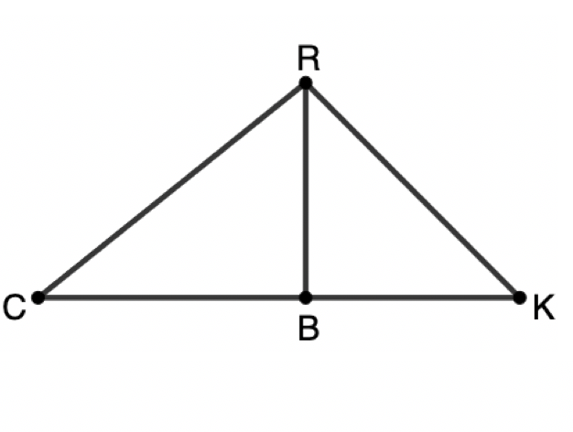
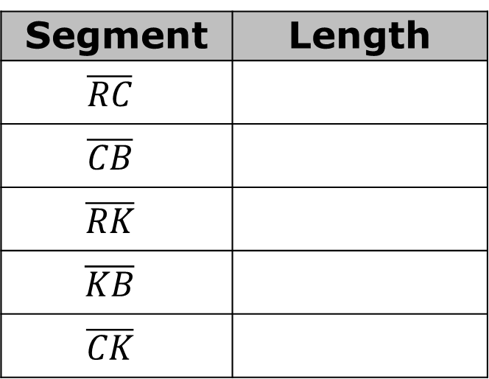

7.8.3 Guided Instruction: Solving Problems With Right Triangles
$∆RBK$ and $∆RBC$ are right triangles that share side $\overline{RB}$. $∠RBK$ and $∠RBC$ are both right angles, $m∠BCR=38.7°$, $m∠RKC=45°$, and $RB=8$.
Use the given information to complete the table. Whenever possible, give lengths as exact values. If necessary, round to the nearest hundredth.
What is the area of $∆CRK$?
Segment | Length
$$\overline{RC}$$
$$\overline{CB}$$
$$\overline{RK}$$
$$\overline{KB}$$
$$\overline{CK}$$
volume 1, pg. 418

Slide 13
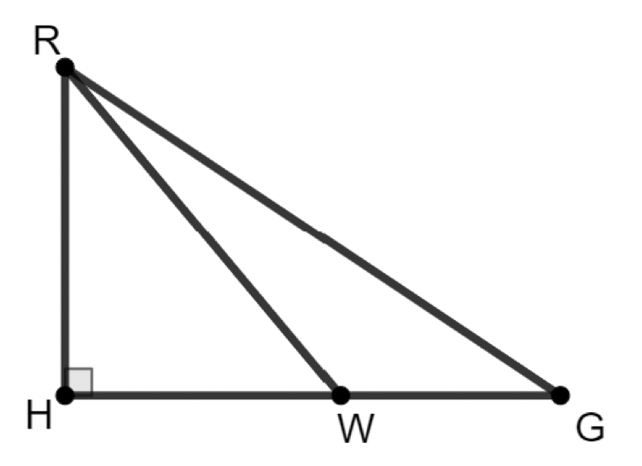

$∆RGH$ is shown, where $m∠RHG=90°$, $m∠RWH=50.2°$, $m∠WRG=16.5°$, $m∠RGH=33.7°$, and $RH=12$.
What is the approximate perimeter of $∆RWG$? Round your answer to the nearest hundredth.
volume 1, pg. 418

Slide 14
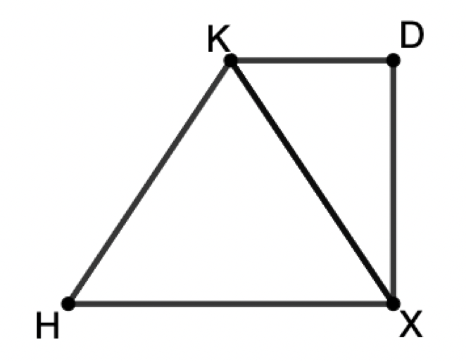

$∆KDX$ and $∆HKX$ share side $\overline{KX}$. $∆HKX$ is an isosceles triangle with base $\overline{HX}$ and $∆KDX$ is a right triangle with $m∠KDX=90°$.
If $HX=13$, $DX=9$, and $m∠KXD=34°$, what is the perimeter of quadrilateral $KDXH$? Round your answer to the nearest hundredth.
volume 1, pg. 419

Slide 15

Guided Practice
volume 1, pg. 419

Slide 16

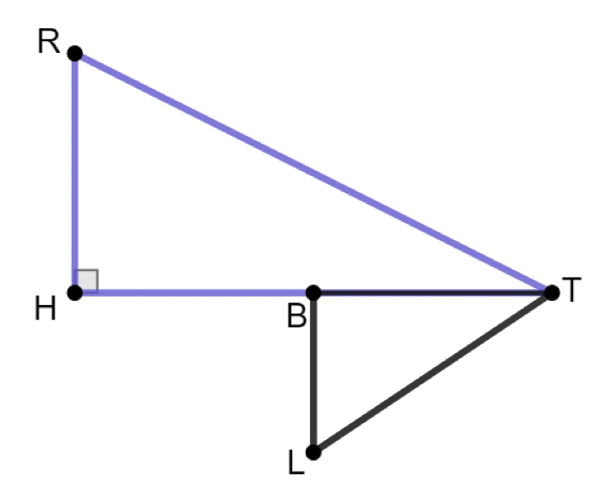

7.8.4 Guided Practice: Right Triangle Trigonometry and the Pythagorean Theorem
$∆RHT$ and $∆TBL$ are right triangles, where $B$ is the midpoint of $\overline{HT}$, $m∠RHT=m∠TBL=90°$, $m∠RTH=30°$, $BL=3$, and $LT=7$.
What is the length of $\overline{HT}$?
What is the area of $∆RHT$?
volume 1, pg. 419

Slide 17

Your Turn
volume 1, pg. 420

Slide 18
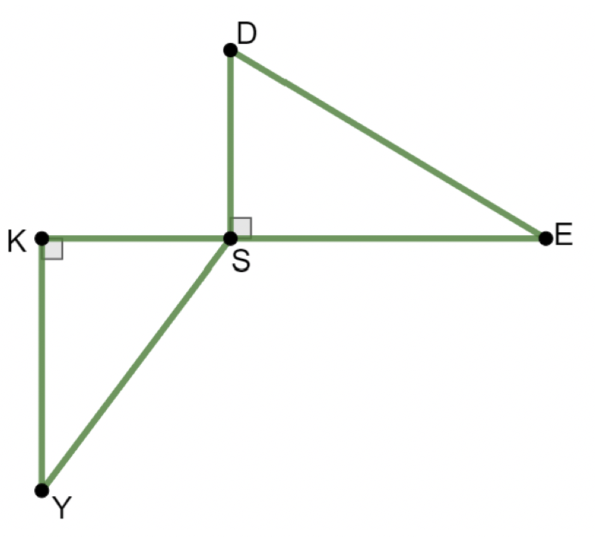

7.8.5 Your Turn!
In the diagram, $∆DSE$ and $∆YKS$ are right triangles that share the vertex $S$. The $m∠DSE=m∠YKS=90°$, $m∠DES=31°$, $m∠KSY=53°$, $KE=37$, and $DS=10$.
Determine the length of $\overline{KY}$.
volume 1, pg. 420

Slide 19
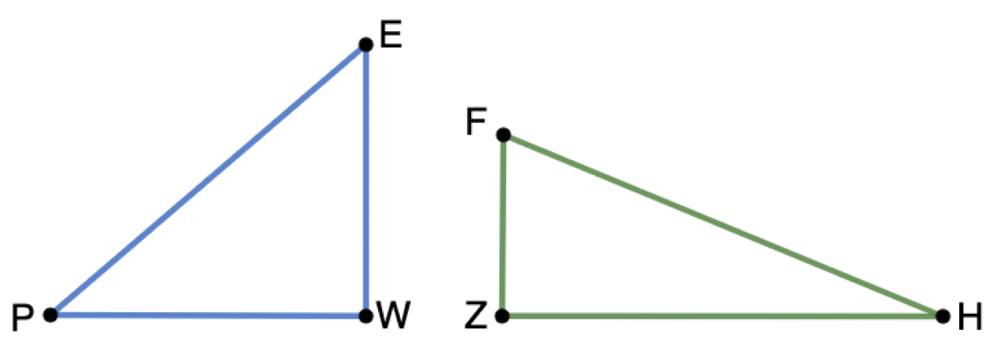

$∆PWE$ and $∆FZH$ are shown. In $∆PWE$, $m∠WEP=49.3°$, $PE=30.6$, and $∠PWE$ is a right angle.
If $∠FZH$ is a right angle, $\overline{FZ}$ is two-thirds the length of $\overline{EW}$, and $\overline{ZH}$ is $1.2$ times longer than $\overline{PW}$, what is the length of $\overline{FH}$?
volume 1, pg. 420

Slide 20

Wrap-Up
volume 1, pg. 421

Slide 21
7.8.6 Wrap-Up: Reflection
Write a summary of what you learned in this lesson.
volume 1, pg. 421

